Slide 1
Building Blocks for Valued Living: Applying RFT principles to supercharge your clinical practice
Jennifer Plumb Vilardaga, PhD
Matthieu Villatte, PhD
World Conference XII Association for Contextual
Behavioral Science, Minneapolis, MN USA
June 19, 2014
VA Puget Sound
Health Care System
Seattle Division

Slide 2
Introduction
Why this matters
What brought us here
Why RFT and Values
Theme: Using language to our advantage

Slide 3
Main goals for today
Help clients answer these 2 questions:
“What do I care about?”
Using language to establish meaning
“How do I make this happen in my life?”
Using language to build flexibility

Slide 4
…ING

Slide 5
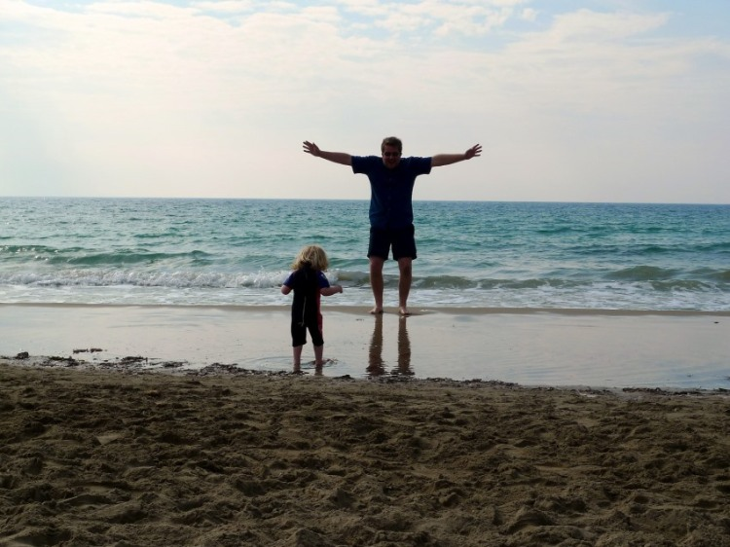
Experiential exercises are one tool…
and RFT can strengthen your toolbox.
The sweet spot

Slide 6
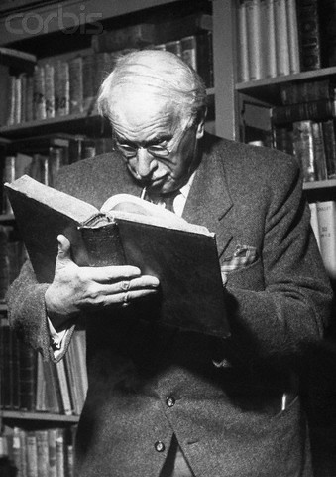
To build meaning, we need reinforcement that is…
Overarching
(not dependent on specific action)
Inexhaustible
(not dependent on specific goal or outcome)
Intrinsic
(not dependent on external reinforcement)
Positive
(not dependent on avoidance or escape)
e.g. Learning

Slide 7
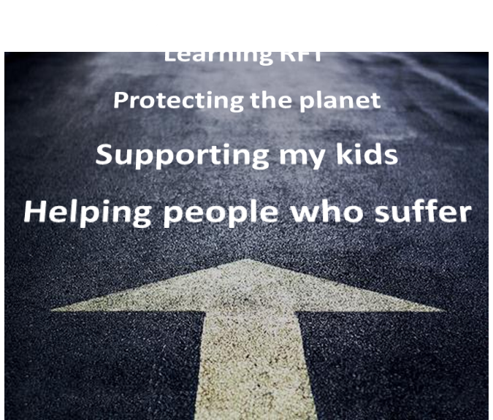
This kind of reinforcement can be found in…
Overarching Goals
Qualities of Action

Slide 8
Using RFT principles to build meaning

Slide 9
Using RFT principles to build meaning
Language is something we do: Building and responding to symbolic relations among things.

Slide 10
=
$410.000

Slide 11
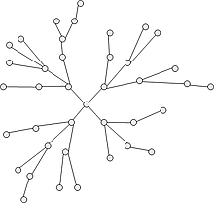
I don’t like sharing my feelings.
REJECTION
SHARING
FEELINGS

Slide 12
What difference would this make in your relationship if you shared your feelings?
DIFFERENCE
RELATIONSHIP
REJECTION
SHARING
FEELINGS
SHARING
FEELINGS

Slide 13
My wife and I would have a closer, more meaningful relationship. We would be more intimate.
DIFFERENCE
RELATIONSHIP
INTIMATE
CLOSER
WIFE
REJECTION
RELATIONSHIP
SHARING
FEELINGS
SHARING
FEELINGS
MEANINGFUL

Slide 14
Building and responding to different kinds of relations = framing
“I don’t want to feel this way”
Distinction/opposition: “What would your life look like if you didn’t feel this way?”
“I cut myself”
Conditional/temporal: “How do you feel before/after?”
“I am a horrible person”
Perspective Taking: “What would you tell your best friend if she said that?”
“I need to get a job”
Hierarchy: “What would getting a job contribute to?”
“I don’t know how to describe this feeling”
Analogy: “If this was a picture, what would you see on this picture?”

Slide 15
Meaning as a hierarchical network
Overarching goals &
Qualities of action
Specific Goal
Action
Action
Specific Goal
Action
Part of
If-Then

Slide 16
Meaning as a hierarchical network
Overarching goals
&
Qualities of action
Specific Goal
Action
Action
Specific Goal
Action

Slide 17
Values work part 1 Building the top of the hierarchy
Overarching goals &
Qualities of action
Specific Goal
Action
Action
Specific Goal
Action

Slide 18
Values work part 1 Building the top of the hierarchy
Overarching goals &
Qualities of action
Specific Goal
Action
Action
Specific Goal
Action
And what would getting a job be part of?
Derive top levels of the hierarchy from specific actions and goals:
Hierarchy

Slide 19
Values work part 1 Building the top of the hierarchy
Overarching goals &
Qualities of action
Specific Goal
Action
Action
Specific Goal
Action
And if you had money, how would your life be different?
Derive top levels of the hierarchy from specific actions and goals:
Condition

Slide 20
Values work part 1 Building the top of the hierarchy
Overarching goals &
Qualities of action
Specific Goal
Action
Action
Specific Goal
Action
Why a house more than an apartment?
Derive top levels of the hierarchy from specific actions and goals:
Comparison

Slide 21
Values work part 1 Building the top of the hierarchy
If anxiety was not a problem, what would your life look like?
When client is focused on problem or outcome:
use opposition or distinction to identify the positive and intrinsic source of reinforcement

Slide 22
Values work part 1 Building the top of the hierarchy
If you found a job but you didn’t tell anybody, would it still be important for you to have a job?
When client is focused on problem or outcome:
use opposition or distinction to identify the positive and intrinsic source of reinforcement

Slide 23
Values work part 1 Building the top of the hierarchy
If you had a magic wand, what would you want to change in your life or in the world?
When nothing seems meaningful:
create or reconnect meaning with condition and perspective taking

Slide 24
Values work part 1 Building the top of the hierarchy
Was there a time when you found meaning in your life? What was that like?
When nothing seems meaningful:
create or reconnect meaning with condition and perspective taking

Slide 25
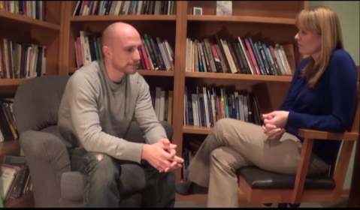
Learn to recognize client’s cues and therapist’s interventions
Derive top levels of the hierarchy from specific actions and goals (condition, hierarchy, comparison…)
Use opposition or distinction to identify the source of positive intrinsic reinforcement
Create or reconnect meaning with condition and perspective taking
Building the top of the hierarchy

Slide 26
Role Plays
Groups of 3: Client, Therapist, Observer
will have 3 practices
Meant to be quick, ordinary – not necessarily your most challenging client just yet
Practice is not performance
Focus is on use of new language techniques
Observer: aim for feedback that is
brief and specific

Slide 27
PRACTICE 1
Scenario: Choose from handout
Therapist help client build the top of the hierarchy
Try to use 2+ of the following:
Condition, Hierarchy, Opposition,
Distinction, Comparison, Perspective Taking
Feedback from observer
Debrief with room

Slide 28
Values work part 2 Building the base of the hierarchy
Overarching goals &
Qualities of action
Specific Goal
Action
Action
Specific Goal
Action

Slide 29
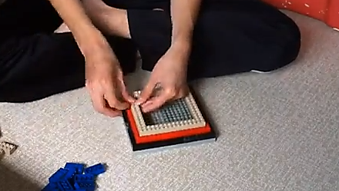
Building the base of the hierarchy: Use of formal exercises
Write a letter to yourself

Slide 30
Values work part 2 Building the base of the hierarchy
Overarching goals &
Qualities of action
Specific Goal
Action
Action
Specific Goal
Action
What are the things you could do that would contribute to your family’s well being?
Use hierarchy to derive parts from the whole

Slide 31
Values work part 2 Building the base of the hierarchy
Overarching goals &
Qualities of action
Specific Goal
Action
Action
Specific Goal
Action
What is the first thing you could do to get closer to finding a job?
Use condition to identify steps

Slide 32
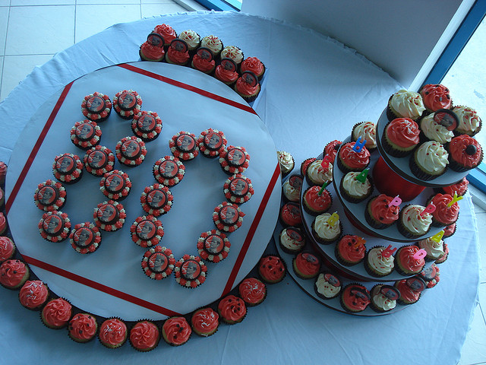
Values work part 2 Building the base of the hierarchy
If you were at your 80th birthday, what actions would you like to remember having done with compassion in your life?
Use perspective taking to increase awareness of potential actions

Slide 33
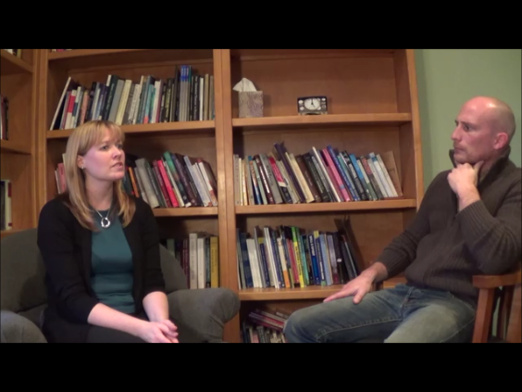
Building the base of the hierarchy
Use hierarchy to derive parts from the whole
Use condition to identify steps (using specific goals)
Use perspective taking to increase awareness of potential actions

Slide 34
PRACTICE 2
Same groups, same client scenario, switch roles
Goal:
1. Help client establish one small action linked
to the top of the hierarchy (value)
2. Use 2+: Condition, Hierarchy, Perspective
Taking
Feedback from observer
Debrief with room

Slide 35
Values work part 3 Develop variability a the base of the hierarchy
Overarching Goals
Qualities of Action
Specific Goal
Action
Action
Specific Goal
Action
EXPANDING

Slide 36
Learn to recognize client’s cues and therapist’s interventions
Use coordination to discover similar actions
Use distinction to discover alternative actions
Use comparison to discover actions of various amplitude
Develop variability at the base of the hierarchy

Slide 37
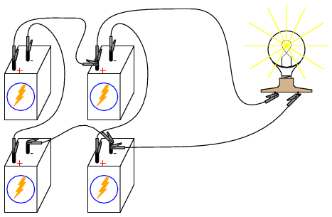
Values work part 3 Develop variability a the base of the hierarchy
What are the other things that you could do that would also contribute to what you care about?
Use coordination to discover similar actions

Slide 38
Values work part 3 Develop variability a the base of the hierarchy
If you couldn’t go hiking because the weather is too bad, what else could you do that would still contribute to exploring?
Use distinction to discover alternative actions

Slide 39
Values work part 3 Develop variability a the base of the hierarchy
Is there something smaller than hiking you could do that would also contribute to exploring?
Use comparison to discover actions of various amplitude

Slide 40
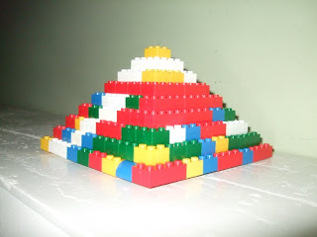
Values work part 3 Develop variability at the base of the hierarchy with exercises

Slide 41
Practice 3: Formal Exercise
Same groups, same client scenario, switch roles
Goal:
1. Develop variability
2. Use Coordination,
Distinction, Comparison
[Remember Hierarchical framing can help you like check if a given action is linked to a value]
Debrief
What if you won $100 000 000?

Slide 42
Summary
RFT provides simple options for coping with challenging client presentations related to values
Try using them in session
Identify the RFT in what you already do!

Slide 43
Additional tools for continued practice
The Language of Psychotherapy
Strengthening Your Clinical Practice with Relational Frame Theory
Matthieu Villatte
Jennifer Villatte
Steven C Hayes
Guilford Press
jcplumb@gmail.com (in VA Outlook – Plumb Vilardaga)
Matthieu.villatte@gmail.com

